Slide 1
Simulating Rocket Trajectories Using Thrust Profiles
DATA 440 Project
Dev Saxena

Slide 2
Project Outline
Simulate the launch of a rocket by graphing its altitude and velocity, and noting important parameters such as apogee, fuel burn rate, and other valuable simulation results
Currently testing for small-scale model rockets but could be scaled up for large-rocket simulations
Aim is to optimize for efficiency so that simulations could be used for real-time systems

Slide 3
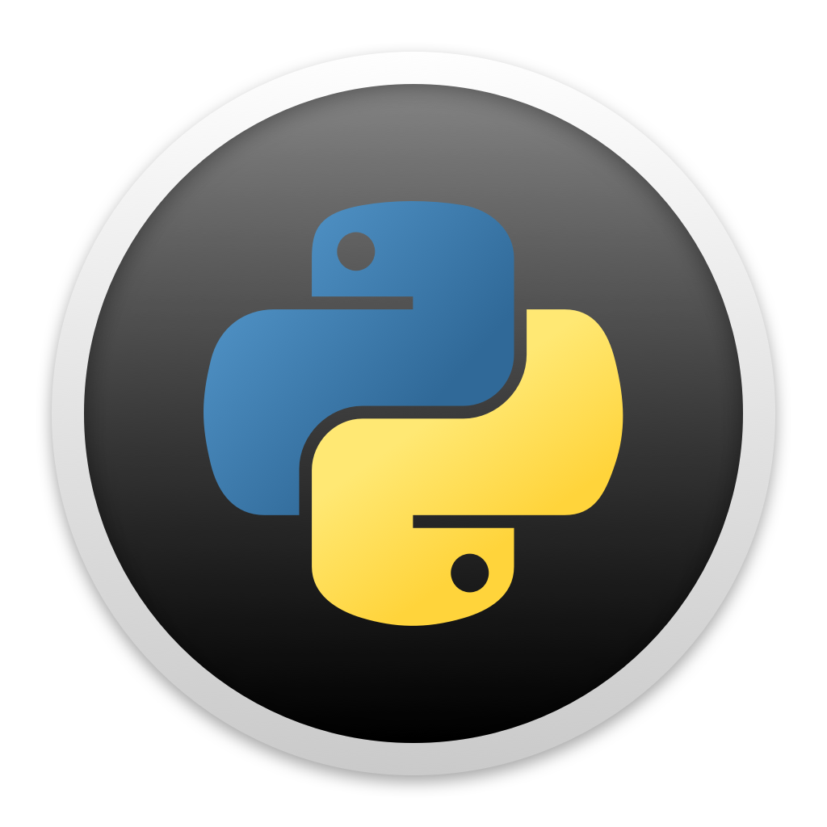
Workflow
User Input
Output
Rocket Parameters
Rocket Mass
Engine Thrust
Fuel Mass
Cross-Sectional Area of Rocket Nose
Simulation Parameters
Step Size (dt)
Environment effects
Initial alt, velocity
Launch angle
Output
Altitude
Velocity
Apogee
…
Simulate

Slide 4
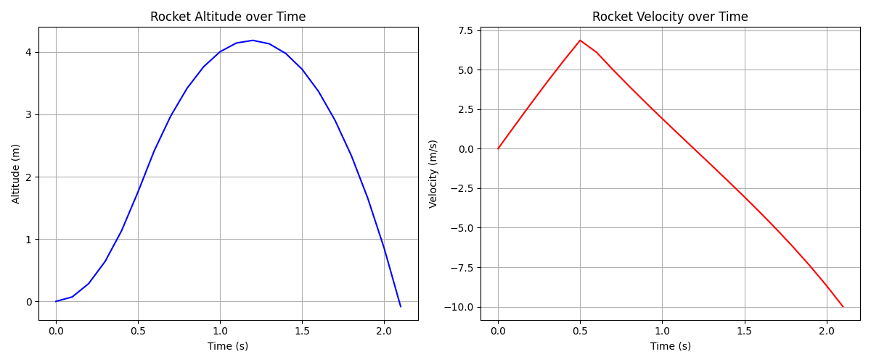
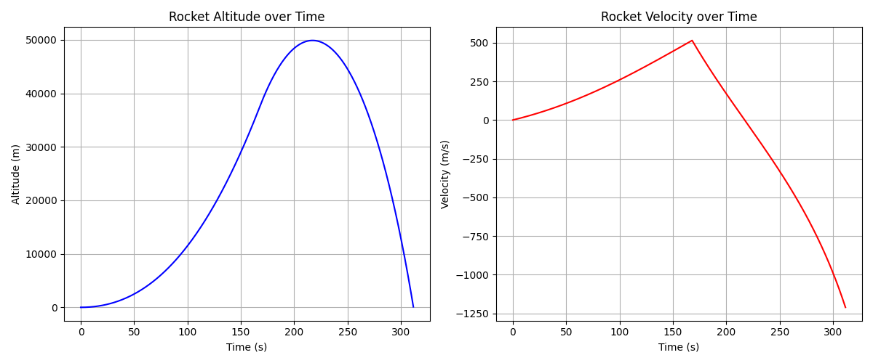
Preliminary Testing Results
Apogee Diamondback Model Rocket with Estes A8 Engine
Saturn V Rocket with 5 Rocketdyne F-1 Engines
Doesn’t accurately simulate spaceflight
More realistic use case once boundary conditions are added
Matches output from an online simulator
Not enough time in air to test other parameters

Slide 5
Next Steps
Create functions to more accurately describe changing thrust and changing air density
Use OOP approach and separate rocket functionality from simulator functionality
Implement boundary conditions for simulation stoppage (example: exiting earth’s atmosphere)
Create a simple pyQt GUI to allow users to input parameters and see output results

